Slide 1


VISION
DOT

Slide 2


Agenda
Introduction
OOPS concepts used
System Overview
Results and system interface
Conclusion References

Slide 3

INTRODUCTION
Braille is a tactile writing system used by people who are
visually impaired. It was invented by Louis Braille in 1824. The system uses patterns of raised dots arrange in cells of up to six dots in a 3×2 configuration. Each pattern represents a character, numeral, or punctuation mark.
Digital Braille Representation
In digital systems, Braille dots are often represented using binary notation:
Dot Positions:
● ●
● ●
● ●
Standard Numbering:
1 4
2 5
3 6

Slide 4






OOPs concept used
Abstraction : Hiding implementation details and showing only essential features
Encapsulation : Bundling data and methods that operate on that data within a single unit Inheritance : Creating new classes based on existing classes
Polymorphism : One interface, multiple implementations
Exception Handling : Handling runtime errors gracefully

Slide 5
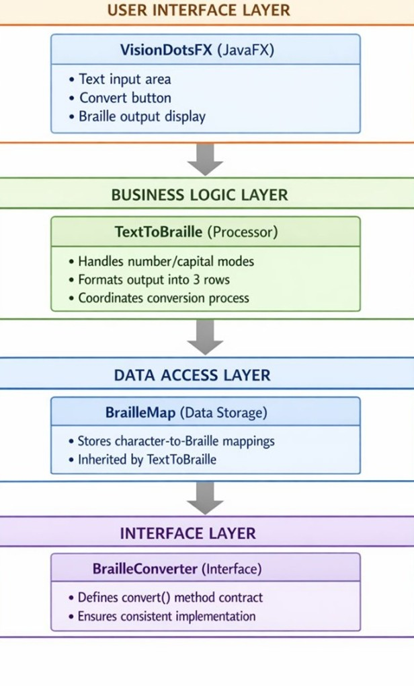

SYSTEM OVERVIEW
UI Layer Text input
Convert button Braille output display
Business Logic Layer
Handles capital & number modes Converts text to Braille
Formats output into 3 rows
Data Layer
Stores character–Braille mappings Uses HashMap structure
Interface Layer
Defines convert() method Ensures consistent conversion

Slide 6
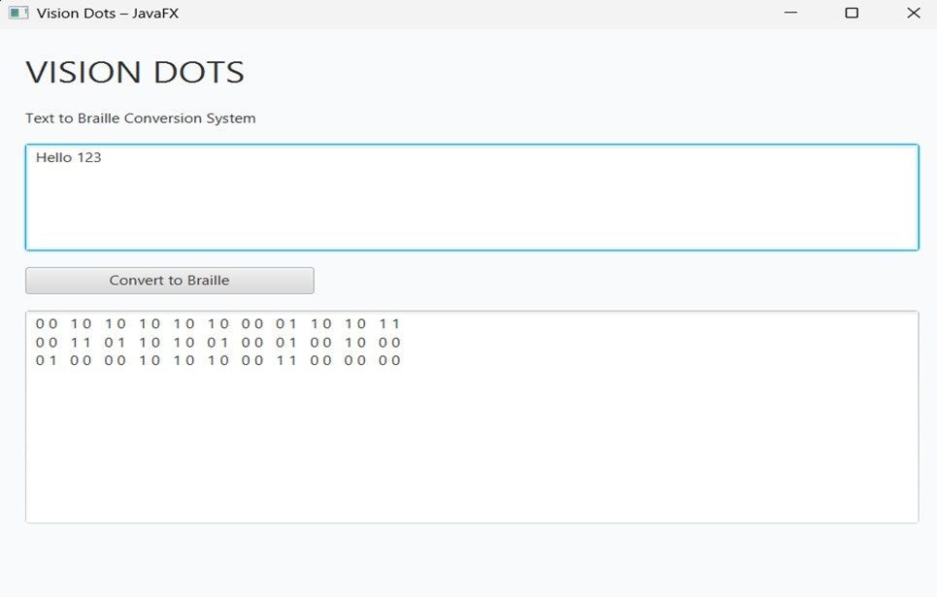
Results and System interface
Braille Encoding Scheme
Letter Mapping Examples:
a = 100000 (● ∘ ∘ ∘ ∘ ∘)
b = 110000 (● ● ∘ ∘ ∘ ∘)
c = 100100 (● ∘ ∘ ● ∘ ∘)
Number Encoding (with number sign prefix):
1 = 001111 100000
2 = 001111 110000
Special Signs: Capital: 000001
Number: 001111
Space: 000000

Slide 7

Conclusion
The Vision Dot project successfully delivers a comprehensive Braille conversion system that transforms English text into Braille
patterns. This project effectively applies core object-oriented programming principles, showcasing modular design and scalability. Th inclusion of a user-friendly graphical interface enhances accessibility, while robust error handling ensures smooth operation.
While currently limited to English characters and Grade 1 Braille without audio or tactile feedback, Vision Dot lays a strong foundatio for educational purposes and Braille learning. Future improvements aim to expand language support, introduce Grade 2 Braille contractions, add audio feedback for visually impaired users, enable export features, and develop a mobile application to broaden usability.
Overall, Vision Dot demonstrates both technical strength and educational value, contributing meaningfully to assistive technology solutions.

Slide 8

References
Official Documentation
Oracle Java Documentation: https://docs.oracle.com/javase/ JavaFX Documentation: https://openjfx.io/
Unicode Braille Patterns: https://unicode.org/charts/PDF/U2800.pdf
Technical Resources
Braille Authority of North America. (2020). Braille Codes and Formats World Blind Union. (2019). International Guide to Braille Notation Java Design Patterns: https://java-design-patterns.com/
Academic References
Deitel, P. J., & Deitel, H. M. (2017). Java: How to Program Bloch, J. (2018). Effective Java
Horstmann, C. S. (2019). Core Java Volume I: Fundamentals
Online Resources
W3Schools Java Tutorial: Basic Java concepts

Slide 9


THANK YOU
By MANISHA CS
MANISH NAYAKA R MANIKANTA KARADIGUDDA MANJU K S

